Slide 1
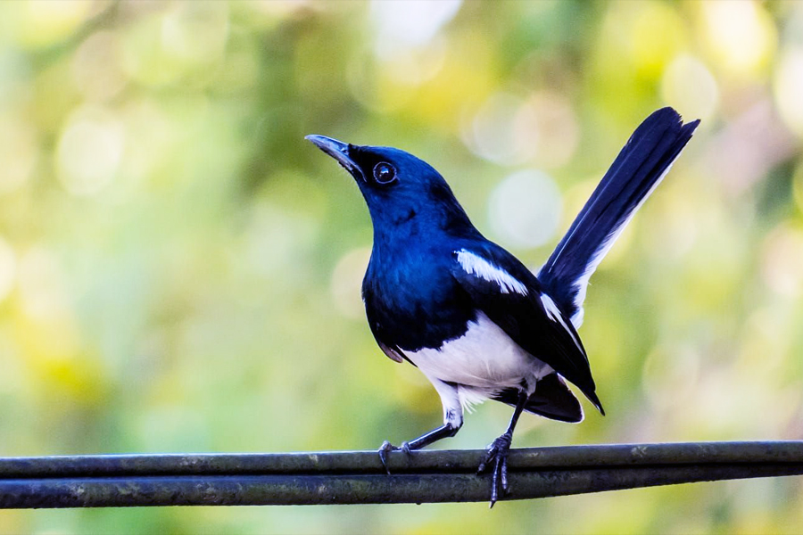
Bangladesh Oriental Magpie Robin

Slide 2
Panthera tigris tigris

Slide 3
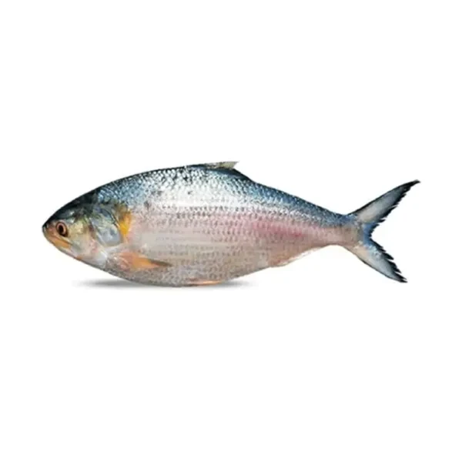
Tenualosa illisha

Slide 4
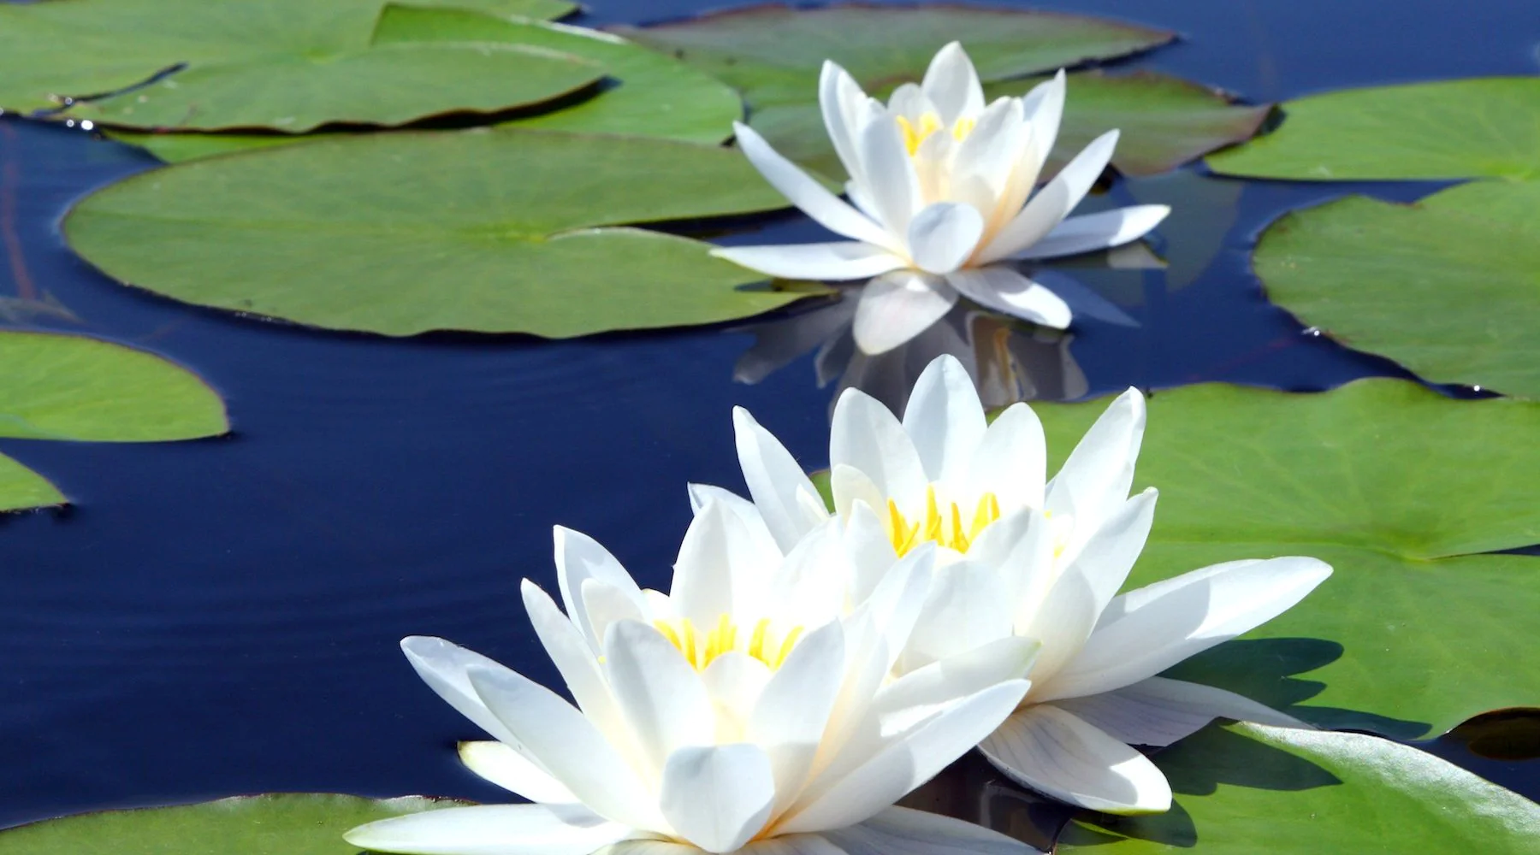
Nymphaea nouchali

Slide 5
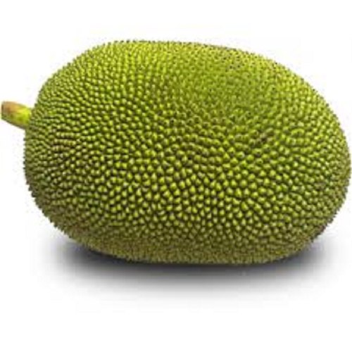
Artocarpus heterophyllus

Slide 6
Bangladesh

Slide 7
Bangladeshi food

Slide 8
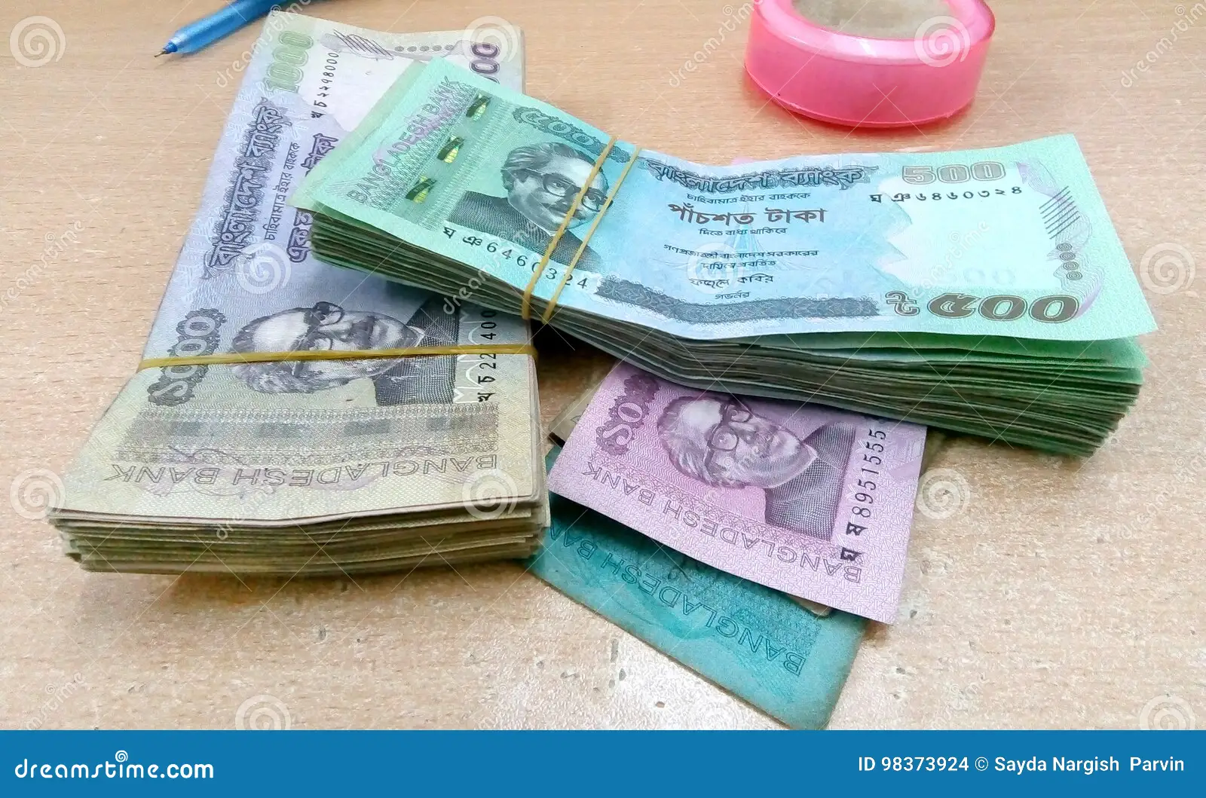
Bangladeshi taka

Slide 9
Padma Bridge

Slide 10
Bangladesh Cricket

